Slide 1
Topics will Be Covered:
AC Parallel Circuit: RL Parallel Circuit; RC Parallel Circuit; RLC Parallel Circuit
Admittance Calculation
Admittance Diagram
Impedance Calculation
Current/Voltage calculation
Current calculation in different branch
Phasor Diagram
Power Calculation
Power Triangle
Current Divider Rule (CDR)
Kirchhoff’s Current Law (KCL)

Slide 2
Chapter 15
Parallel Circuits [AC]

Slide 3
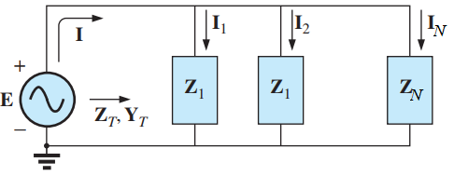
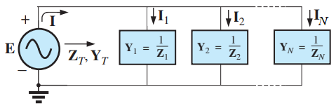
Parallel Configuration
Current
The total impedance of a parallel configuration can be calculated as follows:
The total admittance of a parallel configuration is the sum of the individual admittances:
For two impedance in parallel :
3

Slide 4
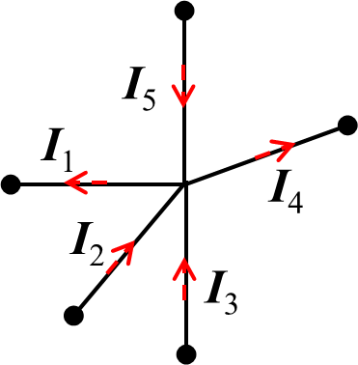
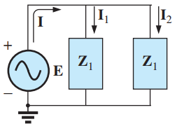
Kirchhoff’s Current Law (KCL)
(1) The algebraic sum of the currents entering and leaving a junction (or region) of a network is zero.
Current Divider Rule (CDR)
(2) The sum of the currents entering a junction (or region) of a network must equal the sum of the currents leaving the same junction (or region).
The current flows through an admittance in a parallel circuit is equal to the value of that admittance (Y_{x}) times the total current (I) divided by the total admittance (Y_{T}) of the parallel configuration.
4

Slide 5
R-L Parallel Circuit
5

Slide 6
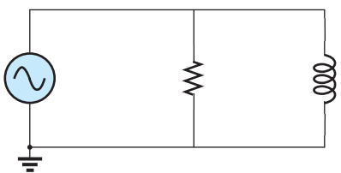
R-L Parallel Circuit
Admittance Diagram
j
I
I_{R}
I_{L}
0.2 S
Y_{R}
+
26.57º
+
E
50V∠0º
R
5 Ω
X_{L}
10 Ω
−
0.1 S
0.224 S
Y_{L}
Y_{T}
Fig. Admittance diagram
Admittance
Impedance
6

Slide 7
R-L Parallel Circuit
KCL:
I
I_{R}
I_{L}
+
Phasor Diagram
E
50V∠0º
R
5 Ω
X_{L}
10 Ω
−
j
10 A
I_{R}
E
26.57º
+
Current
5 A
0.224 S
I_{L}
I
Fig. Phasor diagram
Practice Solution of Fig. 15.68 [Ch. 15], Problems 28 and 30

Slide 8
R-L Parallel Circuit
Apparent Power [volt-ampere]
S_{E} = EI = 50×11.18 = 559.5 VA
S_{Z} = I²Z = (E²/Z)=(50V)²/4.47Ω = 559.72 VA
I
I_{R}
I_{L}
+
Power Triangle
E
50V∠0º
R
5 Ω
X_{L}
10 Ω
−
S = 559.72 VA
Q = 250 Var
26.57º
Power Factor and Reactive Factor
pf = (G/Y_{T}) = cosθ_{z} = cos(26.57º) = 0.894 lagging
rf = (B_{L} /Y_{T}) = sinθ_{z} = sin(26.57º) = 0.447
P = 500 W
Instantaneous Equation
Power [Total watts]
p(t) = 500(1 − cos2ωt) + 250sin2ωt W
P_{E} = EIcosθ_{z} = 50×11.18cos(26.57º) = 500.19 W
P_{R} = I_{R}²R= (E²/R)=(50V)²/5Ω = 500 W
Reactive Power [volt-ampere reactive]
Practice Solution of Fig. 15.68 [Ch. 15], Problems 28 and 30
Q_{E} = EIsinθ_{z} = 50×11.18sin(26.57º) = 250.1 Var
Q_{L} = I_{L}²X_{L} = (E²/X_{L})=(50V)²/10Ω = 250 Var

Slide 9
R-C Parallel Circuit
9

Slide 10
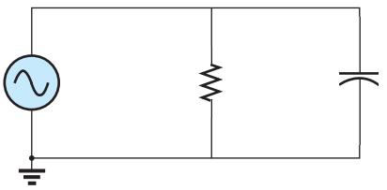
R-C Parallel Circuit
Admittance Diagram
j
I
I_{R}
I_{L}
Y_{C}
Y_{T}
+
E
50V∠0º
R
10 Ω
X_{C}
5 Ω
0.224 S
−
0.2 S
Admittance
63.43º
0.1 S
Y_{R}
+
Fig. Admittance diagram
Impedance
10

Slide 11
R-C Parallel Circuit
KCL:
I
I_{R}
I_{L}
+
Phasor Diagram
E
50V∠0º
R
10 Ω
X_{C}
5 Ω
j
−
I_{C}
I
Current
11.18 A
10 A
63.43º
5 A
I_{R}
E
+
Fig. Phasor diagram
Practice Solution of Fig. 15.72 [Ch. 15], Problem 29

Slide 12
R-C Parallel Circuit
Apparent Power [volt-ampere]
S_{E} = EI
= 50×11.18 VA
= 559.5 VA
S_{Z} = I²Z = (E²/Z)
=(50V)²/4.47Ω
= 559.72 VA
Power Triangle
I
I_{R}
I_{L}
P = 500 W
+
E
50V∠0º
R
10 Ω
X_{C}
5 Ω
63.43º
−
Q = 500 Var
S = 559.72 VA
Power Factor and Reactive Factor
Instantaneous Equation
pf = (G/Y_{T}) = cosθ_{z} = cos(−63.43º) = 0.447 leading
rf = (B_{L} /Y_{T}) = sinθ_{z} = sin(−63.43º) = − 0.894
p(t) = 250(1 − cos2ωt) − 500sin2ωt W
Power [Total watts]
P_{E} = EIcosθ_{z} = 50×11.18cos(−63.43º) = 250.1 W
P_{R} = I_{R}²R= (E²/R)=(50V)²/10Ω = 250 W
Reactive Power [volt-ampere reactive]
Q_{E} = EIsinθ_{z} = 50×11.18sin(−63.43º) = − 500.19 Var
Q_{C} = − I_{C}²X_{C} = −(E²/X_{C})= −(50V)²/5Ω = − 500 Var
Practice Solution of Fig. 15.72 [Ch. 15], Problem 29

Slide 13
R-L-C Parallel Circuit
Example 1
13

Slide 14
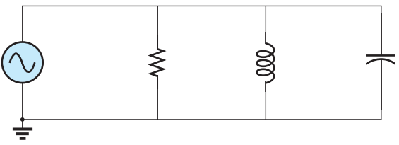
R-L-C Parallel Circuit 1
+
I
I_{R}
I_{L}
I_{C}
E
100V∠0º
R
5 Ω
X_{L}
8 Ω
X_{C}
20 Ω
−
Impedance
Admittance
Admittance Diagram
j
Y_{C}
0.05 S
0.2 S
Y_{R}
20.56º
+
Y_{L} −Y_{C}
0.214 S
Y_{T}
0.125 S
Y_{L}
Fig. Admittance diagram
14

Slide 15
KCL:
+
I
I_{R}
I_{L}
I_{L}
E
100V∠0º
R
5 Ω
X_{L}
8 Ω
X_{C}
20 Ω
Phasor Diagram
−
j
I_{C}
5 A
Current
I_{R}
E
20 A
100 V
20.56º
+
I_{L} −I_{C}
21.37 A
I
12.5 A
I_{L}
Fig. Phasor diagram
Practice Solution of Fig. 15.77 [Ch. 15], Problem 31 to 32

Slide 16
Apparent Power [volt-ampere]
+
I
I_{R}
I_{L}
I_{L}
S_{E} = EI = 100×21.37 = 2137 VA
S_{Z} = I²Z = (E²/Z)=(100V)²/4.68Ω = 2137.75 VA
E
100V∠0º
R
5 Ω
X_{L}
8 Ω
X_{C}
20 Ω
−
Power Triangle
Q_{L}= 1250 VA
Power Factor and Reactive Factor
pf = (G/Y_{T}) = cosθ_{z} = cos(20.56º) = 0.936 lagging
rf = (B /Y_{T}) = sinθ_{z} = sin(20.56º) = 0.351
S = 2137 VA
Power [Total watts]
Q_{L} −Q_{C}
20.56º
P_{E} = EIcosθ_{z} = 100×21.37cos(20.56º) = 2000.23 W
P_{R} = I_{R}²R= (E²/R)=(100V)²/5Ω = 2000 W
P = 2000 W
Reactive Power [volt-ampere reactive]
Q_{C}= 500 VA
Q_{E} = EIsinθ_{z} = 100×21.37sin(20.56º) = 750.09 Var
Q_{L} = I_{L}²X_{L} = (E²/X_{L})=(100V)²/8Ω = 1250 Var
Q_{C} = − I_{C}²X_{C} = −(E²/X_{C})= −(100V)²/20Ω = − 500 Var
Q = Q_{L} + Q_{C} = 750 Var
Fig. Admittance diagram
Practice Solution of Fig. 15.77 [Ch. 15], Problem 31 to 32
16

Slide 17
R-L-C Parallel Circuit
Example 2

Slide 18
R-L-C Parallel Circuit 2
I = 10A∠20.56º
I_{R}
I_{L}
I_{L}
+
E
R
5 Ω
X_{L}
20 Ω
X_{C}
8 Ω
−
Impedance
Admittance
Admittance Diagram
j
Y_{C}
0.125 S
Y_{T}
0.214 S
Y_{C} −Y_{L}
20.56º
0.2 S
Y_{R}
+
0.05 S
Y_{L}
Fig. Admittance diagram
18

Slide 19
KCL:
I = 10A∠20.56º
I_{R}
I_{L}
I_{L}
+
E
R
5 Ω
X_{L}
20 Ω
X_{C}
8 Ω
−
Phasor Diagram
j
Current
I_{C}
5.84 A
I
I = 10 A
I_{C} −I_{L}
20.56º
0.2 S
I_{R}
E
+
2.34 A
I_{L}
Fig. Phasor diagram

Slide 20
Apparent Power [volt-ampere]
+
I
I_{R}
I_{L}
I_{L}
S_{E} = EI = 46.73×10 = 467.3 VA
S_{Z} = I²Z = (E²/Z)=(46.73V)²/4.68Ω = 468 VA
E
46.73V∠0º
R
5 Ω
X_{L}
20 Ω
X_{C}
8 Ω
−
Power Triangle
Q_{L} = 109.51 Var
Power Factor and Reactive Factor
pf = (G/Y_{T}) = cosθ_{z} = cos(−20.56º) = 0.351 leading
rf = (B /Y_{T}) = sinθ_{z} = sin(− 20.56º) = − 0.936
P = 437.39 W
20.56º
Power [Total watts]
Q_{C} −Q_{L}
S = 467.3 VA
P_{E} = EIcosθ_{z} = 46.73×10cos(− 20.56º) = 437.39 W
P_{R} = I_{R}²R= (E²/R)=(46.73 V)²/5Ω = 437.11 W
Reactive Power [volt-ampere reactive]
Q_{C} = 272.84 Var
Q_{E} = EIsinθ_{z} = 46.73×21.37sin(− 20.56º) = − 164.02 Var
Q_{L} = I_{L}²X_{L} = (E²/X_{L}) = (46.73V)²/20Ω = 109.51 Var
Q_{C} = − I_{C}²X_{C} = −(E²/X_{C}) = −(46.73V)²/8Ω = − 272.84 Var
Q = Q_{L} + Q_{C} = − 163.33 Var
Fig. Phasor diagram
Practice Solution of Fig. 15.77 [Ch. 15], Problem 31 to 32
20

Slide 21
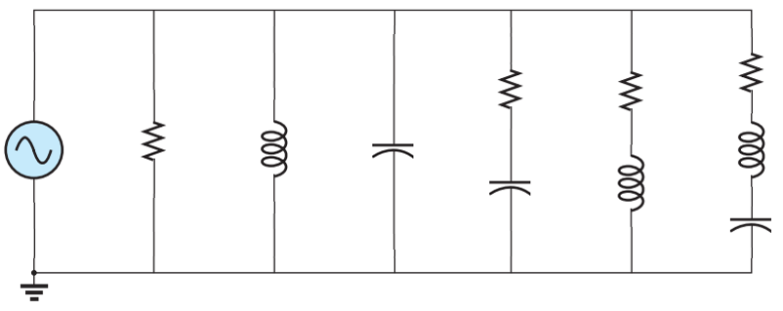
Problem: For the following network:
(a) Find the conductance, susceptance and admittance for each branch.
(b) Determine the total admittance, impedance and the source current I_{s}.
(c) Using the current divider rule, determine the currents I₁, I₂, I₃, I₄, I₅, and I₆.
(d) Determine the power consumption each resistor.
(e) Determine the reactive power consumption each inductor.
(f) Determine the reactive power supply by each capacitor.
(g) Find the total number of watts, volt-amperes reactive, and volt-amperes, and the power factor.
I₁
I₂
I₃
I₄
I₅
I₆
I_{s}
R₆
8.66 Ω
R₄
16 Ω
R₅
15 Ω
E = 120V∠0º
R₁
X_{L1}
X_{C1}
25 Ω
X_{L3}
10 Ω
10 Ω
X_{C2}
X_{L2}
20 Ω
20 Ω
12 Ω
X_{C3}
5 Ω
21

Slide 22
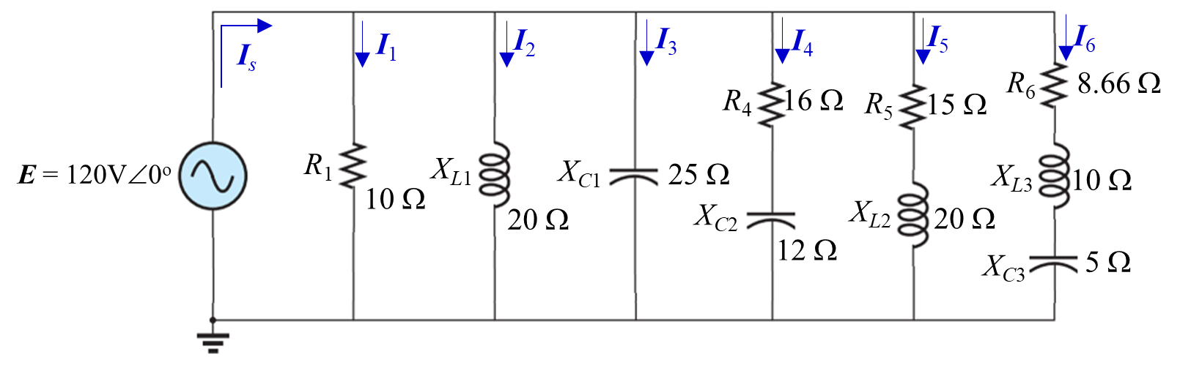
For | Conductance [S] | Susceptance [S]
Z₁ or Y₁ | 0.1 | 0
Z₂ or Y₂ | 0 | 0.05
Z₃ or Y₃ | 0 | 0.04
Z₄ or Y₄ | 0.04 | 0.03
Z₅ or Y₅ | 0.024 | 0.032
Z₆ or Y₆ | 0.087 | 0.05
Solution: Let,
22

Slide 23
(c) Using the current divider rule, determine the currents I₁, I₂, I₃, I₄, I₅, and I₆.
23

Slide 24
(d) Determine the power consumption each resistor.
(e) Determine the reactive power consumption each capacitor.
(e) Determine the reactive power consumption each inductor.
24

Slide 25
(g) Find the total number of watts, volt-amperes reactive, and volt-amperes, and the power factor.
Total number of watts:
Total number of volt-amperes reactive:
Total number of volt-amperes:
Power factor:
25

Slide 26
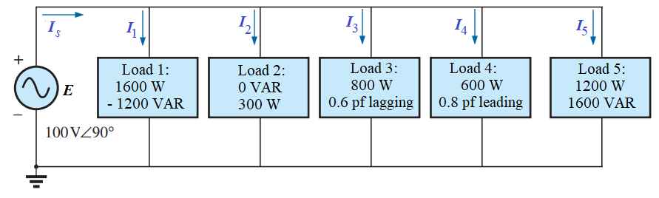
Problem: For the following network: Find the total number of watts, volt-amperes reactive, and volt-amperes, and the power factor.
Solution:
Load 3: Power factor lagging, so circuit is reactive power is positive.
$$θ_{z3}=\cos^{−1}\left[0.6\right]=53.13°$$
$${Q_{3}=Ptanθ}_{z3}=800×tan\left(53.13°\right)=1066.67 VAR$$
Load 4: Power factor leading, so circuit is reactive power is negative.
$$S_{T}=\sqrt{P_{T}^{2}+Q_{T}^{2}}=4613.41 VA$$
$$θ_{z4}=−\cos^{−1}\left[0.8\right]=−36.87°$$
$$pf= \frac{P_{T}}{S_{T}}=0.975$$
$${Q_{4}=Ptanθ}_{z4}=600×\tan\left(−36.87°\right)=−450 VAR$$
P_{T} = 1600 W + 300 W + 800 W + 600 W + 1200 W = 4500 W
Q_{T} = −1200 VAR + 1066.67 VAR − 450 VAR + 1600 VAR = 1016.67 VAR
26

Slide 27
Problem: For the following network: Determine the currents I_{s}, I₁, I₂, I₃, I₄, I₅, and I₆.
Solution: Here,
E = 100 V and θ_{e} = 90º.
Load 1: Reactive power is negative, so circuit is capacitive and impedance angle is negative.
$$θ_{z1}=\tan^{−1}\left[\frac{Q}{P}\right]=\tan^{−1}\left[\frac{−1200}{1600}\right]=−36.87°$$
Load 2: Reactive power is zero, so circuit is resistive and voltage and current are in phase.
$$θ_{z2}=0°$$
$$θ_{i1}=θ_{e}−θ_{z1}=90°−\left(−36.87°\right)=126.87°$$
$$θ_{i2}=θ_{e}−θ_{z1}=90°−0°=90°$$
$$I_{1}=\frac{P}{Ecosθ_{z1}}=\frac{1600}{100×\cos\left(−36.87°\right)}=20 A$$
$$I_{2}=\frac{P}{Ecosθ_{z2}}=\frac{300}{100×\cos\left(0°\right)}=3 A$$
$$I_{1}=20A126.87°=−12+j 16 A$$
$$I_{2}=3A90°=j3 A$$
27

Slide 28
Load 3: Power factor lagging, so circuit is inductive and impedance angle is positive.
$$θ_{z3}=\cos^{−1}\left[0.6\right]=53.13°$$
$$θ_{i3}=θ_{e}−θ_{z3}=90°−53.13°=36.87°$$
$$I_{3}=\frac{P}{Ecosθ_{z3}}=\frac{800}{100×0.6}=13.13 A$$
Load 5: Reactive power is positive, so circuit is inductive and impedance angle is positive.
$$I_{3}=13.13A36.87°=10.66+j 8 A$$
$$θ_{z5}=\tan^{−1}\left[\frac{Q}{P}\right]=\tan^{−1}\left[\frac{1600}{1200}\right]=53.13°$$
Load 4: Power factor leading, so circuit is capacitive and impedance angle is negative.
$$θ_{i5}=θ_{e}−θ_{z5}=90°−−53.13°=36.87°$$
$$θ_{z4}={−cos}^{−1}\left[0.8\right]=−36.87°$$
$$I_{5}=\frac{P}{Ecosθ_{z5}}=\frac{1200}{100×\cos\left(53.13°\right)}=20 A$$
$$θ_{i4}=θ_{e}−θ_{z4}=90°−\left(−36.87°\right)=126.87°$$
$$I_{4}=\frac{P}{Ecosθ_{z4}}=\frac{600}{100×0.8}=7.5 A$$
$$I_{5}=20A36.87°=16+j 12 A$$
$$I_{s}=I_{1}+I_{2}+I_{3}+I_{4}+I_{5}=10.16+j45$$
$=46.1377.28°$
$$I_{4}=7.5A126.87°=−4.5+j 6 A$$
28

